Slide 1


Operating System
Threads
Presented by
Prasanga Raman Pokharel
Roshan Limbu

Slide 2



Table of Contents
a.
Introduction of Thread
b.
Types
c.
Process
d.
Multi-threading
e.
Benifits of multithreading
2024/01/28

Slide 3

Introduction
A thread stands as the fundamental unit of processing, representing the smallest entity capable of execution.
A thread exist within a process.
It is the smallest unit of processing that can be performed in an OS.
i.eSingle process consist of multiple thread
A thread is know as lightweight process.
A single threaded process consists of single thread, while multithreads process consists of multiple thread.

Slide 4
Types of Threads
There are two types of threads:
User Threads
Kernel Threads
03/12

Slide 5
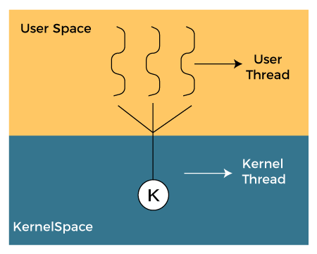
User Level Threads (ULT)
Is implemented in the user level library, they are not created using
the system calls. Thread switching does not need to call OS and to cause
interrupt to Kernel. Kernel doesn’t know about the user level thread and
manages them as if they were single-threaded processes.
Managed through application.
Implemented by user.
Easy implementation.
Not recognized by OS.
Less context swith time.

Slide 6
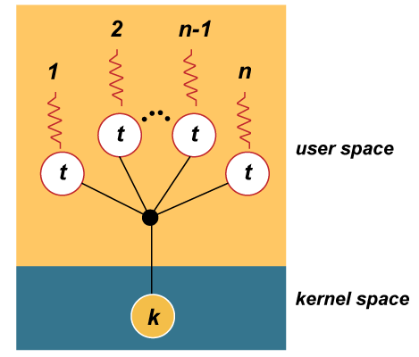
Kernel Level Thread (KLT)
Kernel knows and manages the threads. Instead of thread table in each process, the kernel itself has thread table (a master one) that keeps track of all the threads in the system. In addition kernel also maintains the traditional process table to keep track of the processes. OS kernel provides system call to create and manage threads.
Managed by kernel.
Implemented by OS.
Complicated implementation.
Recognized by OS.
More context switch time.
Hardware support is required

Slide 7
Multithreading
Multithreading is a programming and execution model that allows multiple threads to exist within the context of a single process. A thread is the smallest unit of execution within a process, and multithreadiing enables multiple threads to run concurrently, sharing the same resources and address space. This can lead to improved performance, responsiveness, and effeciency.

Slide 8
Benefits of Multithreading
Concurrency: Multiple threads can execute independently, allowing for concurrent execution of tasks.
Responsiveness: Multithreading can improve the responsiveness of applications, particularly in user interface and real time-systems.
Effeciency: Threads can share data and resources, reducing the overhead of creating separate process.
Parallelism: Multithreading enables parallelism, allowing different threads to perform tasks simultaneously on multi-core processors.
03/12

Slide 9
challenges of multithreading
Race conditions: When multiple threads access shared data concurrently, the order of execution can lead to unpredictable outcomes.
Deadlocks: Occurs when two or more threads are blocked forever, waiting for each other to release resources.
Starvation: Some threads may be denied access to resources indefinitely.
03/12

Slide 10

Thank you!

